Slide 1

SET Conference Review 1
A Deep Learning Approach for
Detection and Classification
of
Plant Leaf Disease
Under the Guidance:
Prof. Vanitha M.
Dipak Kumar Paul (19MCA0077)
Srideep Kar (19MCA0229)

Slide 2
Abstract
Diseases in the leaves of plants are very crucial issue in this day and due to which yield of high-quality crops gets devasted, and the longevity of the plant hampers. And also, it is very difficult to understand the current condition of the leaf with the naked eye. Which results in the reduction of yield of high-quality crops. To overcome this problem, we planned to use machine learning based approach to segment, to select every small part of the leaf and detect the disease, also to analyse the quality of the plant. The main vision of the research is to detect all possible diseases of the leaves of the plant by applying Neural Network to classify the part of disease based on the colour changes in comparison to the analytical available data set, providing the best fit output.

Slide 3
Introduction
Deep learning has made a significant progress in a wide domain of machine learning: image classification, object recognition, object detection, speech recognition, language translation, etc. Many deep learning empowered applications are life crucial, raising great concerns in the field of safety and securities.
The proposed work identifies the disease on the plant leaf segment and classify the leaf that it contain disease or not. To perform image processing, we are using TensorFlow and CNN(Convolutional Neural Network). To data augmentation we have used TensorFlow (Keras) to generate images.

Slide 4
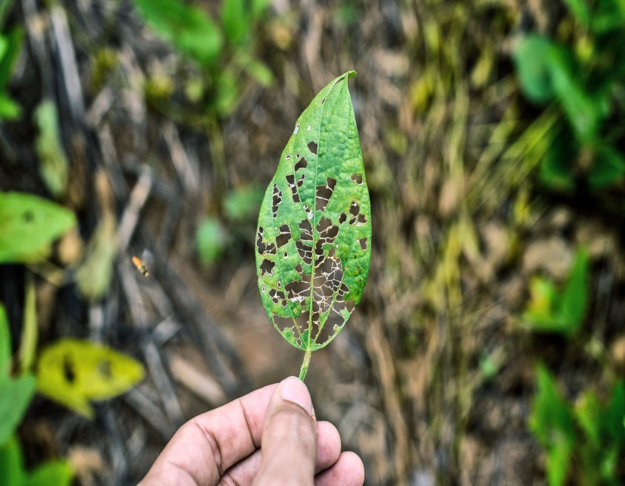
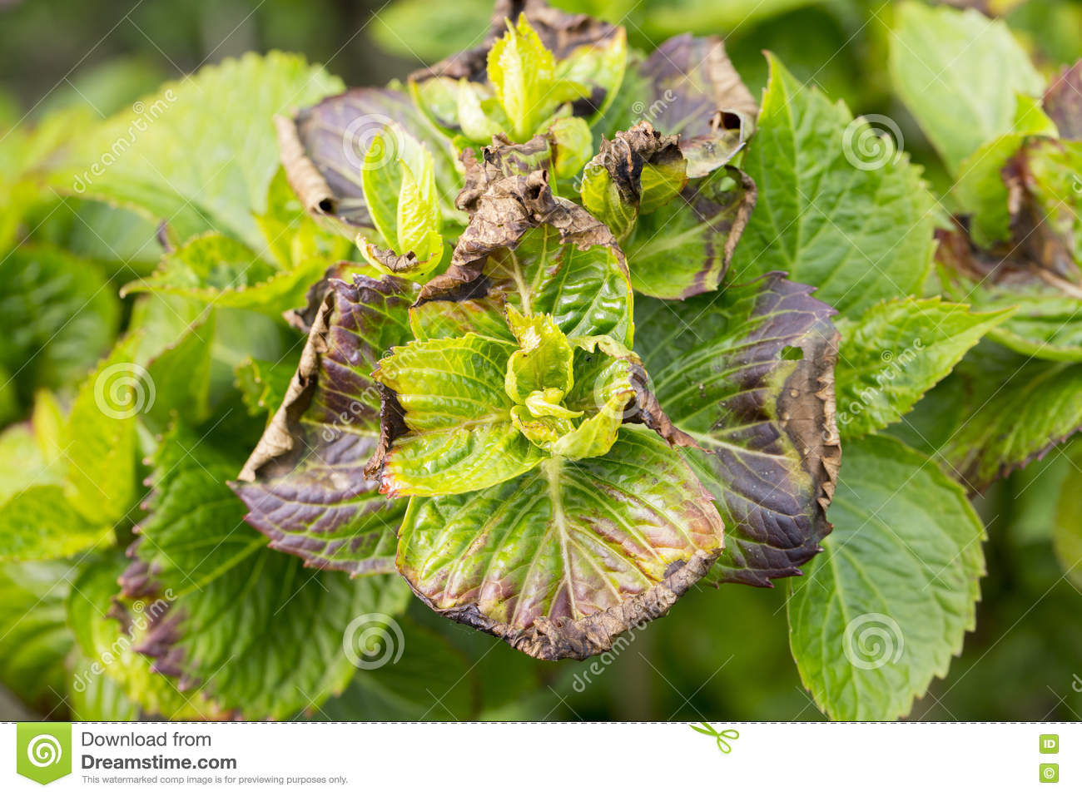
Problem Statement
Detection Of Healthy and Unhealthy Leaves

Slide 5
Block Diagram
Input Data
Data Pre Process
Apply CNN Model
Prediction
Statistical Report Analysis

Slide 6
Literature Survey
Detection of Disease in Cotton Leaf using Artificial Neural Network by Nikhil Shah, Sarika Jain.
Detection of Diseases on Cotton Leaves Using K-Mean Clustering Method by Pawan P. Warne, Dr. S. R. Ganorkar.
Classification of Leaf disease using Texture Feature and Neural Network Classifier by Neha G. Kurale & Madhav V. Vaidya
Plant Leaf Disease Detection and Classification Based on CNN with LVQ Algorithm by Melike Sardogan, Adem Tuncer, Yunus Ozen
Detection and Classification of Groundnut Leaf Diseases using KNN classifier by M.P.Vaishnnave
Computer Vision image Enhancement For Plant Leaves Disease Detection by Dr.K.Thangadurai
Detection of unhealthy region of plant leaves using Image Processing and Genetic Algorithm by Vijai Singhv
Detection of Disease in Cotton Leaf using Artificial Neural Network by Nikhil Shah
Plant Leaf Disease Detection and Classification Based on CNN with LVQ Algorithm by Melike Sardogan
Diseases Detection of Various Plant Leaf Using Image Processing Techniques by Santhosh Kumar.S
Detection of Leaf Diseases and Classification using Digital Image Processing by R.Meena Prakash
Classification of Leaf disease using Texture Feature and Neural Network Classifier. by Neha G. Kurale

Slide 7
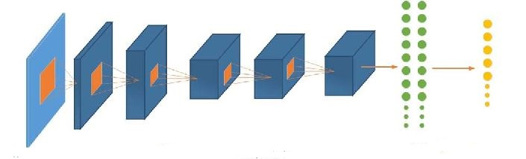
Proposed System(CNN)
Convolutional Layers + ReLu + pooling
Fully Connected Layers
Input Data
Outputs

